Slide 2
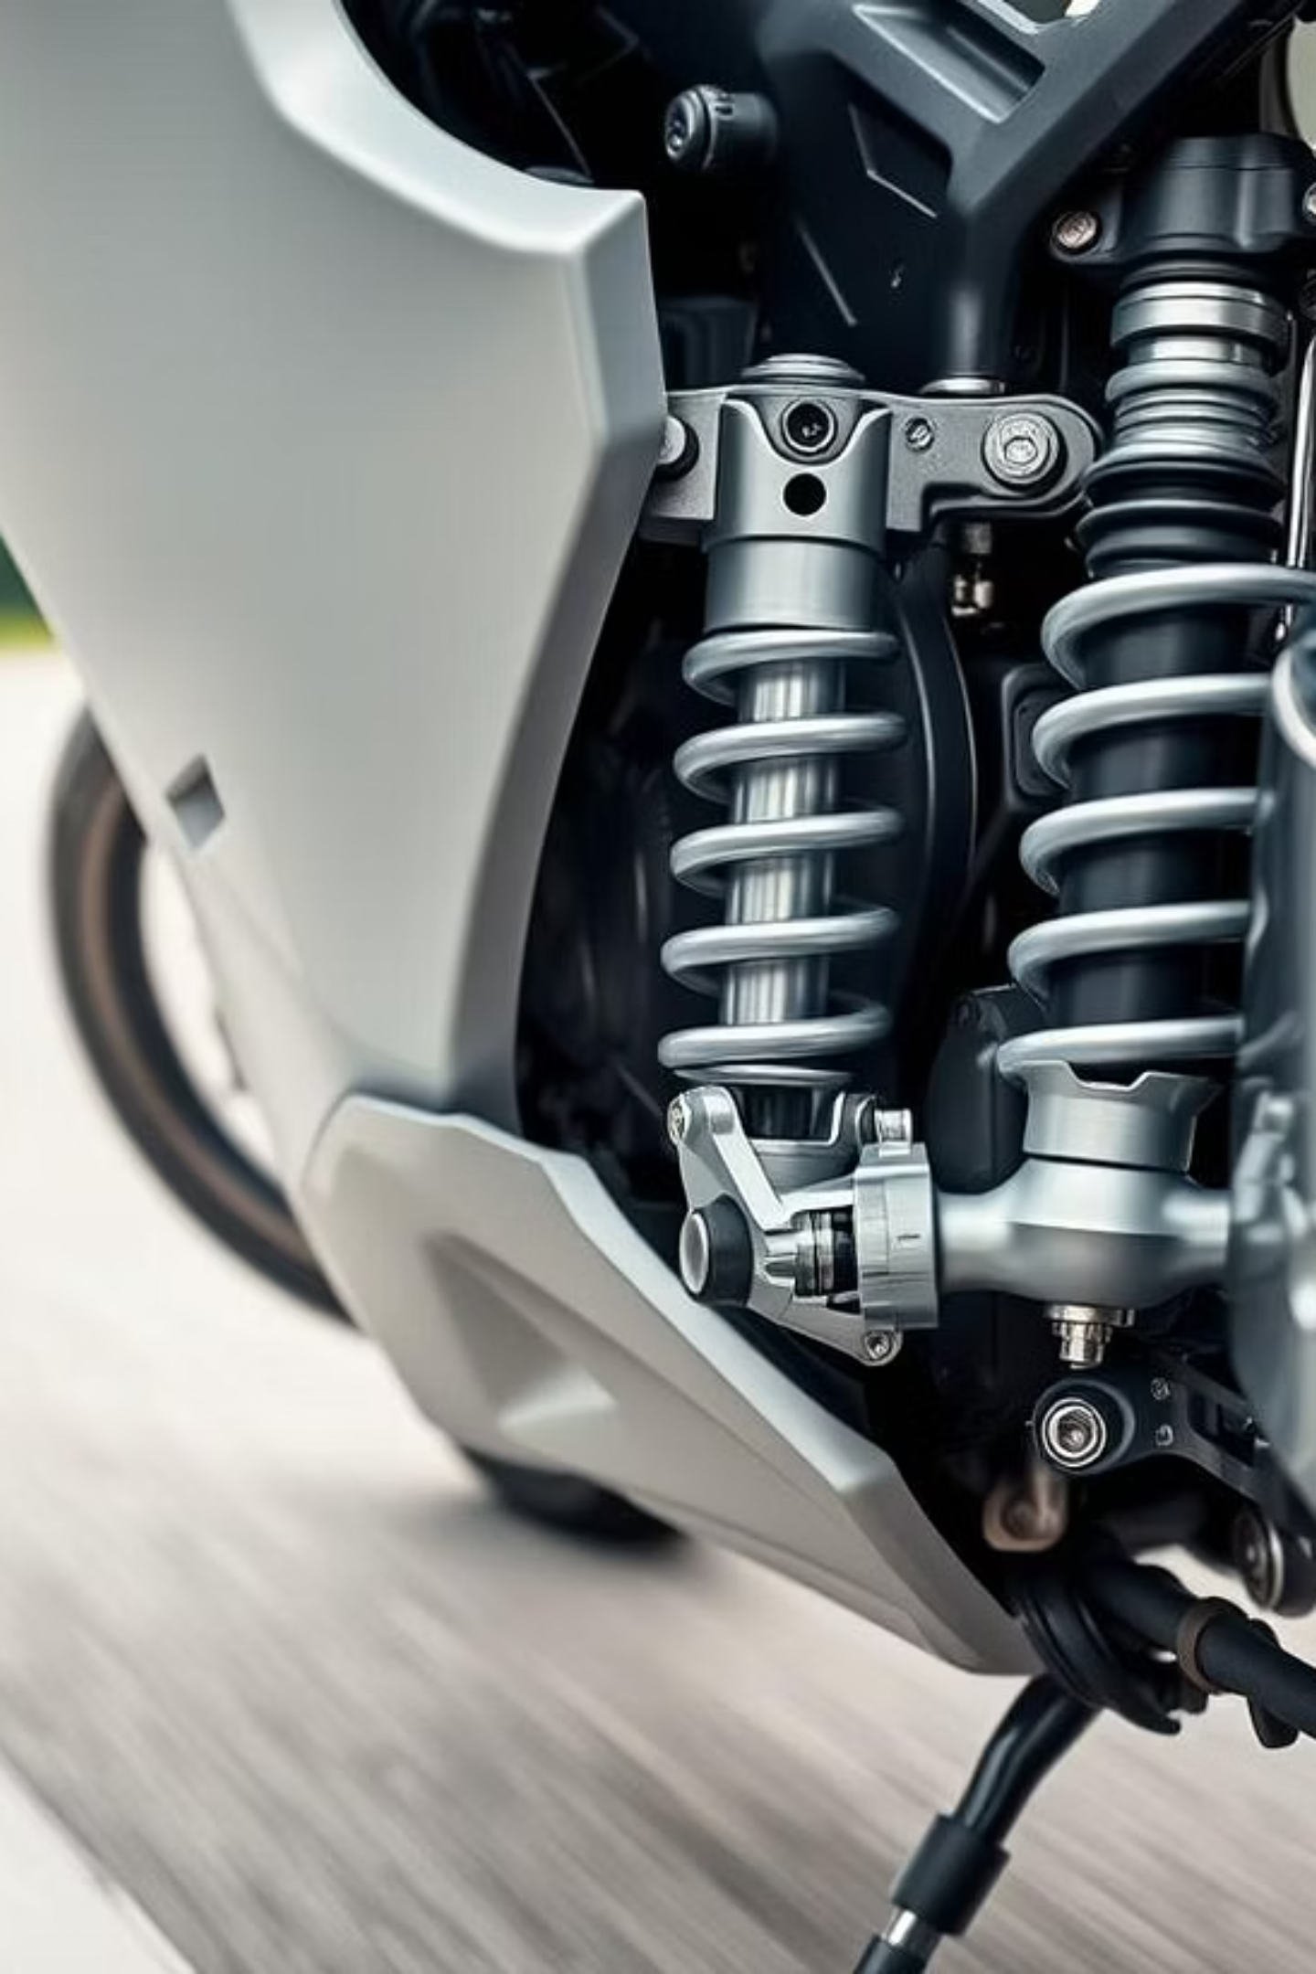
GATIK OTTO
Driving Comfort. Ensuring Safety.

Slide 3
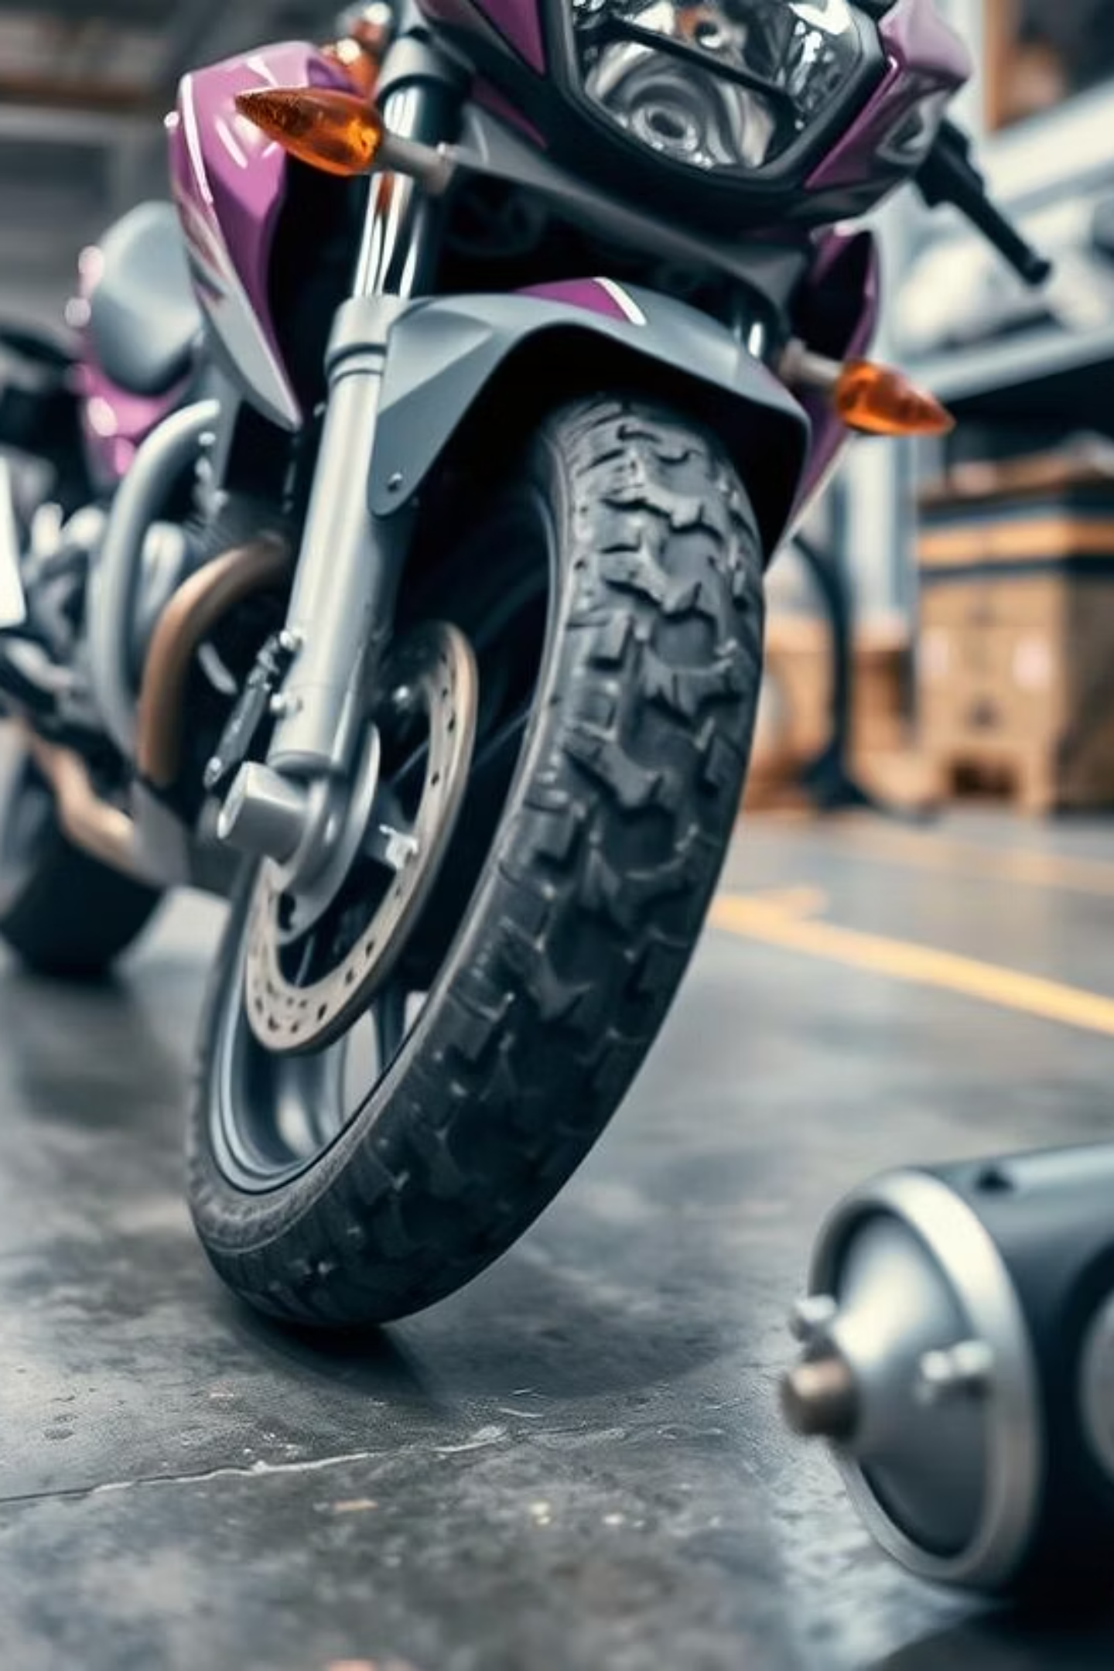
About GATIK OTTO
GATIK OTTO is an innovative manufacturer of two-wheeler suspension systems (front forks & rear cushions), headquartered in India. We are committed to delivering unparalleled ride comfort, ensuring safety, and enhancing overall vehicle performance for the evolving Indian and global automotive market.

Slide 4

Vision & Mission
Vision
To be the most trusted partner for advanced suspension solutions globally, setting benchmarks in ride dynamics and vehicle safety.
Mission
Deliver superior quality and reliability
Continuous innovation in suspension technology
Exceptional customer support and partnership
Promote sustainable mobility solutions

Slide 5
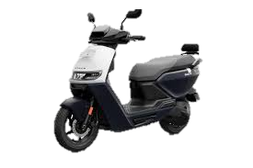
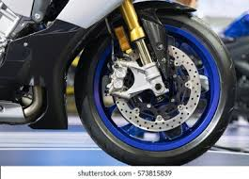
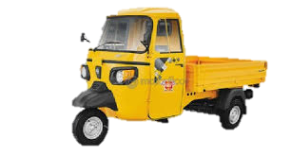
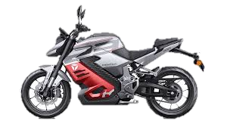
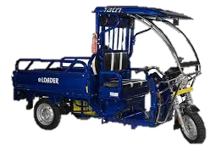
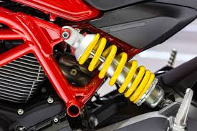
Product Portfolio
Front Forks
Rear Cushions
Superior damping control for smooth rides
Adjustable preload for varied loads
Optimized for diverse Indian road conditions
Improved load handling and comfort
Enhanced stability and steering response
Long-life seals for maximum durability

Slide 6





Manufacturing Strength
CNC Machining
Contamination free Assy Room
Precision engineering for critical components ensuring accuracy and consistency.
Prevent dust, dirt, and airborne particles from entering the assembly area and ensures cleaner components, critical for parts like front forks and rear cushions, where even small contaminants can cause oil leaks or premature wear.
.
Advanced Testing Labs
Large-Scale Production
Rigorously testing products for performance, durability, and safety under extreme conditions.
Capability to meet high volume demands while maintaining stringent quality controls.

Slide 7


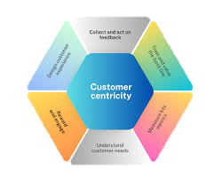



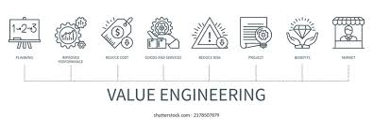

Technology & Innovation
Continuous R&D
1
Driving future advancements as well as Continuous product upgrades
Customer-centric engineering
2
Enhanced durability
Problem-solving approach
3
Analyzing and solving field issues and customer feedback
Focus on VA/VE
4
Systematic approaches to improve the value of products
Our R&D is deeply focused on resolving real-world challenges faced by customers today — ensuring every ride is safer, smoother, and worry-free

Slide 8

Quality Assurance
1
2
3
100% Inspection
Endurance & Reliability
Zero Defect Commitment
Every single product undergoes rigorous checks to ensure adherence to the highest standards.
Comprehensive testing simulating real-world conditions guarantees long-term performance and safety.
Our unwavering pledge to eliminate defects at every stage of manufacturing process.

Slide 9

Customer Benefits
Tailored customization to meet specific OEM requirements
Localized supply chain for efficient logistics and cost-effectiveness
Faster development cycles, accelerating time to market
Strong service support and technical assistance

Slide 10

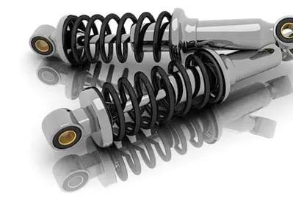
Our Core Team
OTTO's success is driven by a dynamic team led by experienced professionals in suspension technology. Our dedicated engineers and manufacturing experts collaborate to push boundaries, innovate solutions, and maintain our commitment to excellence. We foster a culture of continuous learning and growth.
DIRECTOR
DIRECTOR
DIRECTOR
Co-founders

Slide 11
Sustainability & CSR
Eco-Friendly Production
Energy Optimization
Community & Employee Welfare
Implementing green technologies and waste reduction methods for minimal environmental impact.
Focus on renewable energy sources and efficient consumption across all operations.
Engaging in local community development and ensuring the well-being of our workforce.

